Slide 1

WaitLess
Virtual Queue Manager for Real Life
Your time is valuable. Don't waste it in line.

Slide 2




The Problem: Long Queues, Lost Time
We've all been there – endlessly waiting in lines, whether at the canteen, clinic, or bank. It's frustrating, inefficient, and a significant drain on our precious time.
Wasted Time
Hours spent standing, when you could be doing something productive or enjoyable.
Crowded Spaces
Uncomfortable and often unhygienic environments, especially in busy areas.
Poor Experience
Leading to customer dissatisfaction and negative perceptions of businesses.

Slide 3

WaitLess: Your Virtual Queue Solution
Introducing WaitLess, a smart web application designed to revolutionize how we wait. Say goodbye to physical lines and hello to virtual convenience. Join queues from anywhere and get notified when it's your turn!

Slide 4

How It Works: Simple & Seamless Flow
Join Queue Virtually
Tap a link to enter a virtual queue from your smartphone.
Real-Time Updates
See your position in the queue and estimated wait time instantly.
Get Notified
Receive an alert when your turn is near, allowing you to arrive just in time.

Slide 5
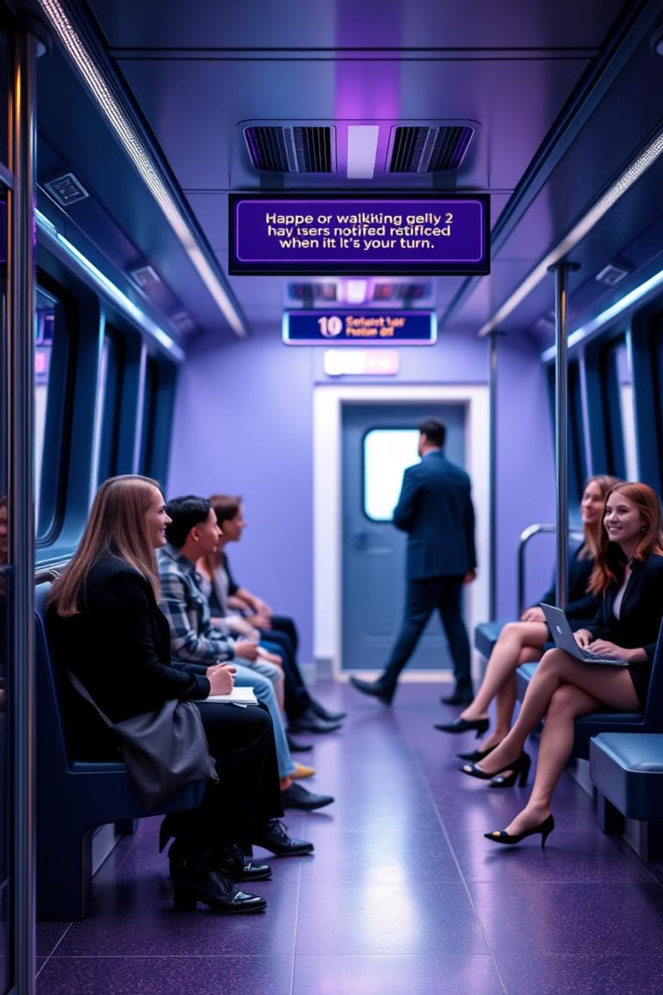
Demo Walkthrough: See WaitLess in Action
Watch our quick demo to experience the intuitive interface and seamless functionality of WaitLess.
(In the github repo)

Slide 6





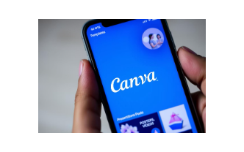
Our Tech Stack: Building WaitLess
WaitLess is built on a robust and scalable foundation of modern web technologies.

Slide 7





AI Integration: Powering Our Development
Artificial intelligence played a crucial role in various stages of WaitLess's development, accelerating our progress and enhancing our output.
Idea Generation
ChatGPT helped brainstorm core features and user flow for a seamless experience.
Content Writing
Assisted in crafting clear and concise text for the application and pitch deck.
UI Suggestions
Provided insights and ideas for a modern, intuitive user interface design.
Video Scripting
Aided in creating the script for our demo video, ensuring a compelling narrative.

Slide 8
Impact, Future
Key Benefits
Time Saving: Users reclaim valuable time, reducing frustration.
Connect with us and try the demo:
Reduced Crowding: Improves comfort and safety in public spaces.
Team Code Crafters
Enhanced Experience: Businesses offer a modern, efficient service.
Future Plans
Mobile App: Native applications for iOS and Android.
Smart Queuing: Location-based services for automated check-ins.
Admin Dashboard: Comprehensive tools for business owners.
SMS Alerts: Alternative notification methods for all users.

Slide 9
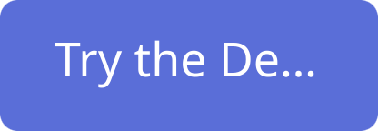

Thank You!
We appreciate your time and interest in WaitLess. We're committed to enhancing efficiency and user experience.

